Slide 1
Point Cloud Project

Slide 2

What is a point cloud?
unordered
Defn: collection of data points plotted in a 3D coordinate system
created through LiDAR(laser scanning), photogrammetry
often contain additional data to coordinates (color, intensity etc.)

Slide 3
PointNet
PointNet++
Point Transformer
same group
Goal: processing raw point cloud directly without converting it to voxel/image
Problem: PointNet does not capture local structure
Problem: unordered input, geometric transformations
Method: hierarchical local features,
set abstraction layers
Method: max pooling, alignment
Idea: unordered input(set) ~ self attention(learns relations between set elements)

Slide 4
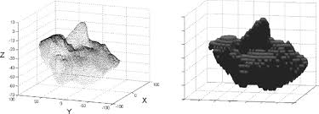
Why not voxel?
memory cost
fine grained detail
inefficiency bcs. of empty space
…

Slide 5
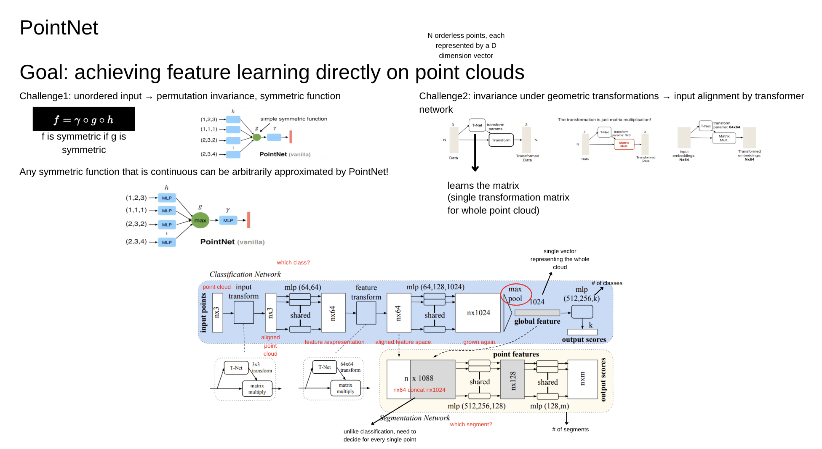
before Pointnet, they converted 3D data into other types to be compatible with CNNs

Slide 6
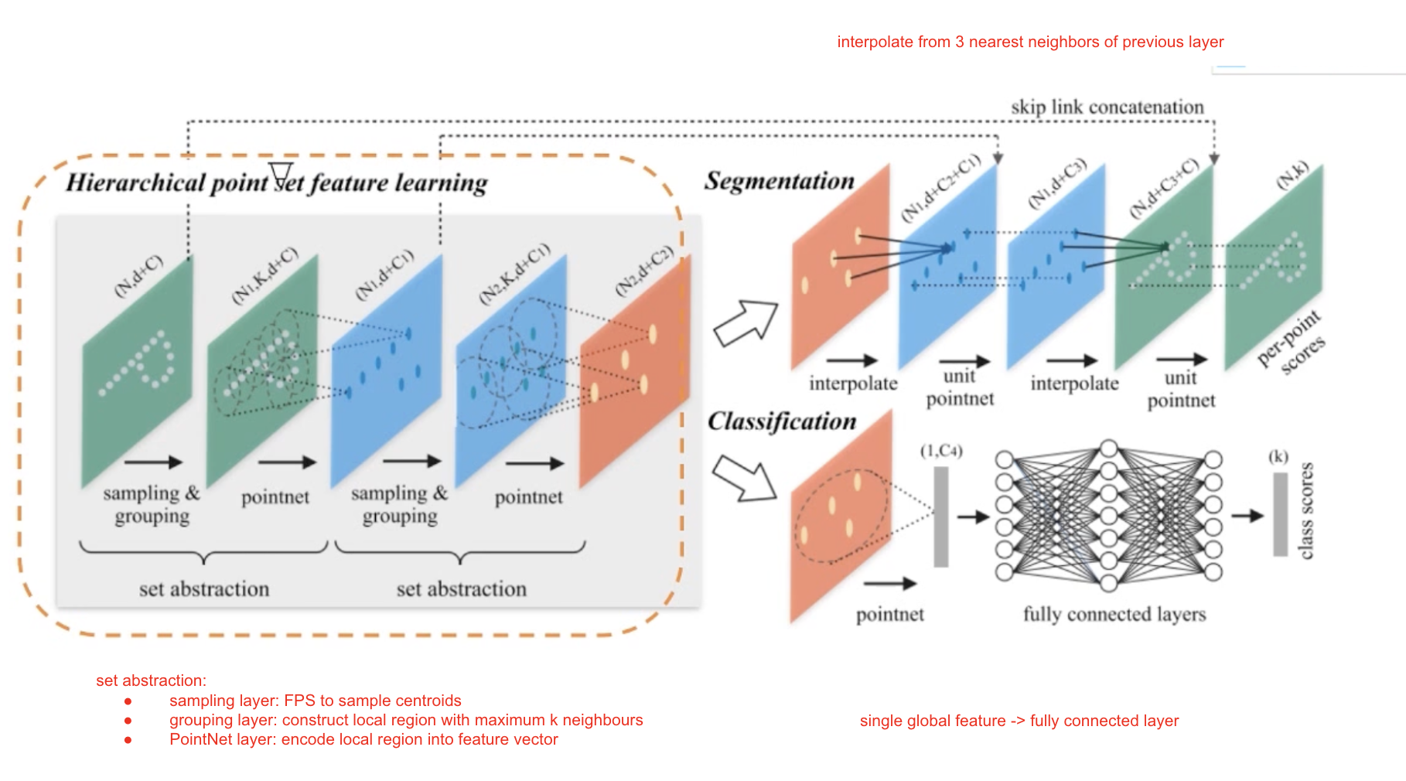
PointNet++
Problem: feature extractions for Pointnet do not capture local structure
Method: set abstractions, hierarchical learning

Slide 7
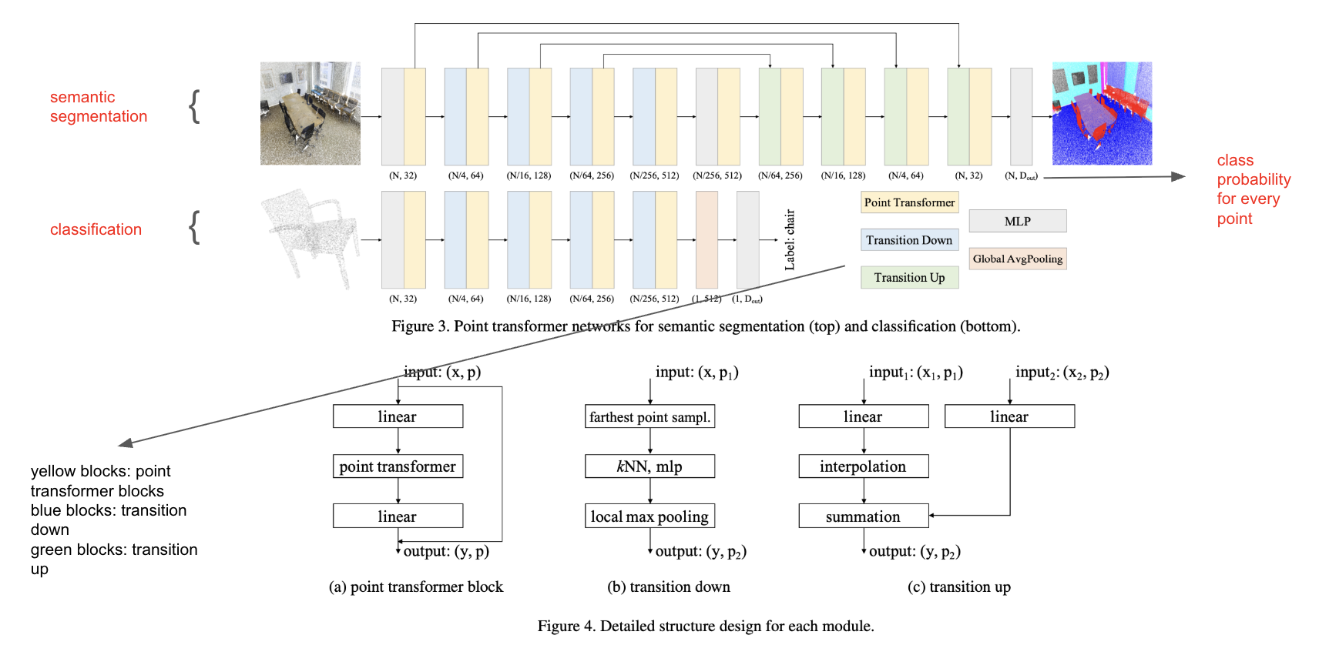
Point Transformer
Problem: learn features respecting local geometry + relationships between neighboring points(maxpooling x)
Method: attention to decide how much each neighbor should contribute

Slide 8

Point Cloud Registration
Defn: aligning two or more point clouds into the same coordinate system
RANSAC?
corr. point in the second point cloud
point in the first point cloud

Slide 9
FCGF
PREDATOR
Goal: geometric feature extraction for registration
Problem: learning based representations are slow
Method: sparse 3D fully convolutional network, single pass,
do not directly make classification/semantic segmentation, find matches
low overlap regions
new benchmark 3DLoMatch from 3DMatch
overlap-attention block
GeoTransformer
Deep Closest Point
keypoint free (patch level matching)
pair-wise distances and triplet-wise angles
soft learning correspondances
rigid transformation via SVD

Slide 10
Fully Convolutional Geometric Features
Goal: geometric feature extraction
do not directly make classification/semantic segmentation, find matches
32 dimensional feature vector for every point
Problem: handcrafted 3D features, learning based patch descriptors(slow, limited receptive field)
select point → patch → network → feature
Method: Fully Convolutional Geometric Features
whole scan → one forward pass → feature for all points
patch based before
computing features separately

Slide 11
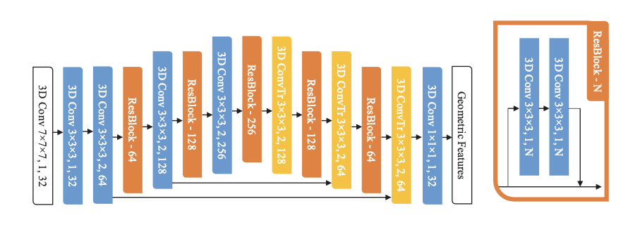
ResUNet
voxel grid,
sparse tensor

Slide 12
PREDATOR
Problem: hard to find true matches when there is few overlap (eg. %10–30)
Method: find overlap region, focus on that region while finding keypoints
overlap-attention block
Output:
1. Feature descriptor
2. Overlap score -> points that are not in the overlap region may be useless
3. Matchability score -> very similar, matching is hard

Slide 13
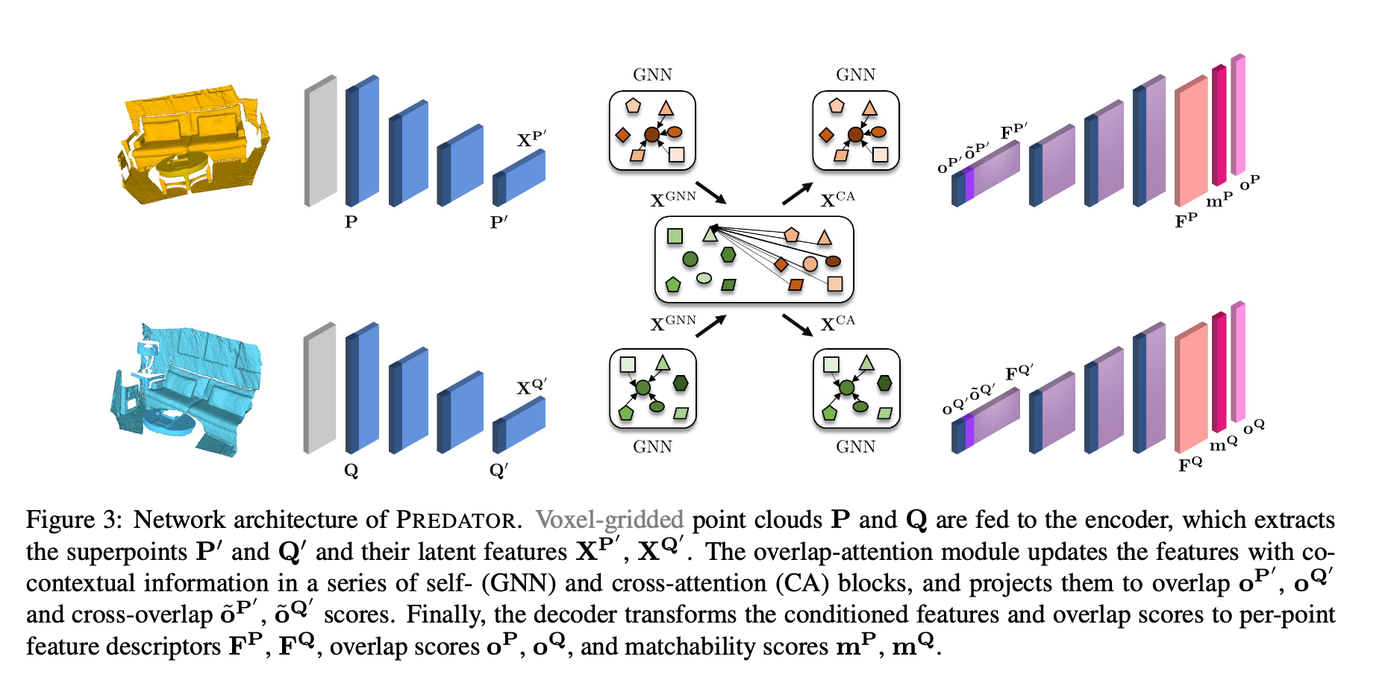
latent features: feature vector that model learns per every superpoint
}
decoder
}
encoder
geometric context inside the point cloud
make a more consistent overlap estimate by including neighboring regions
-> overlap aware latent features
}
superpoints
overlap attention block
soft correspondence/attention weights
superpoints

Slide 14
GeoTransformer
Problem: vanilla transformer doesn't use the geometric structure of the point cloud clearly enough
Method: geometric structure embedding (pair-wise distances + triplet-wise angles)
correspondence extraction, then estimating transformation
superpoints

Slide 15
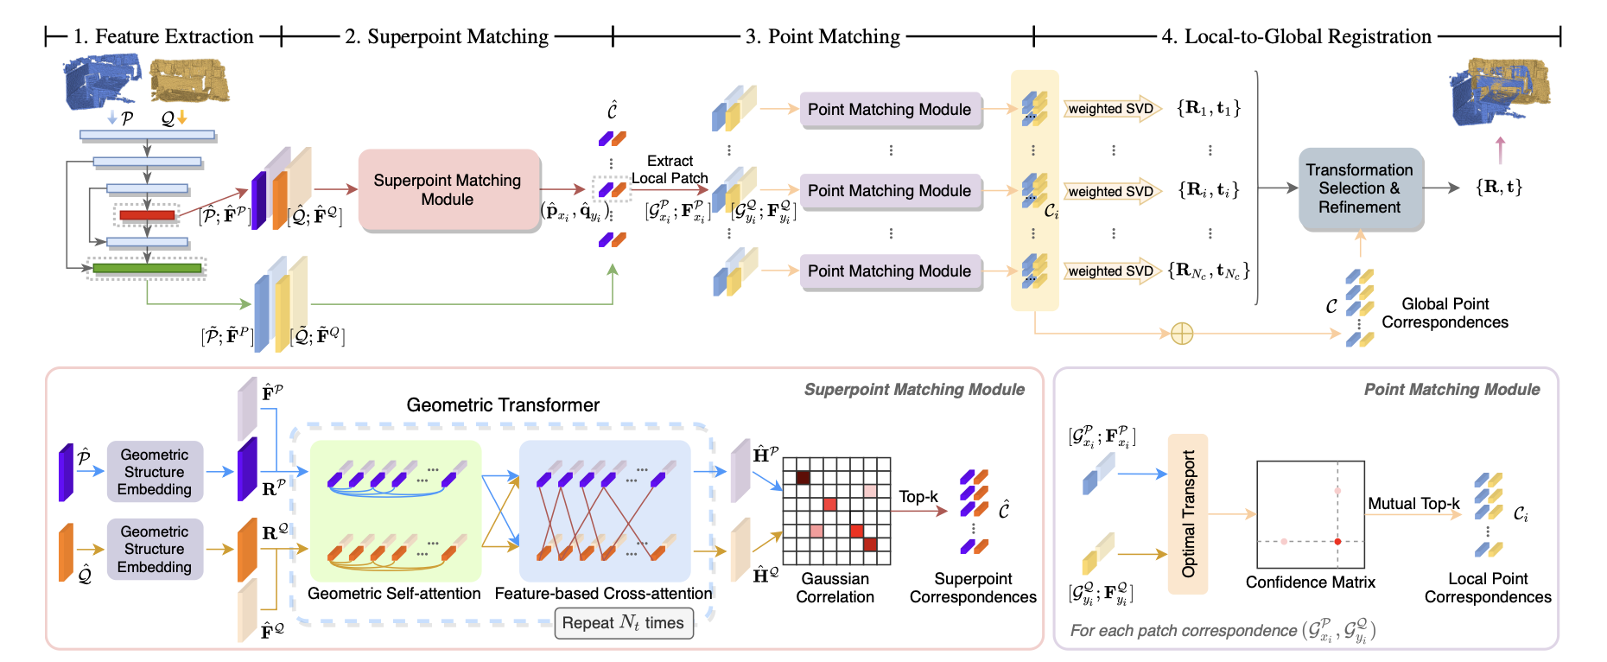

Slide 16
Point Cloud Completion
estimating the entire object/scene from an incomplete or partial point cloud

Slide 17
PCN
Pointr
Goal: using raw point clouds instead of voxels
encoder(global feature vector, i.e. extended Pointnet)
decoder(coarse-to-fine)
Limitation: loss of fine grained detail bcs. of compression to a single global vector
keep local regions as proxy tokens
observed -> Transformer(to reason) -> missing
SnowflakeNet
AdaPointr
global shape code
splitting like a snowflake
adaptive query generation and denoising query task
“we reduce training time (by 15x or more) and improve completion performance
(over 20%)” (Abstract)

Slide 18
PCN: Point Completion Network
Problem: predicting Y(set of dense 3D points, uniformly sampled from observed and unobserved surface of the object) given X(set of 3D points, sampled from observed surface of the object)
i.e. “X is not necessarily a subset of Y”
Supervised Learning
PCN: encoder -> coarse decoder(Y_coarse) -> detailed decoder(Y_detail)
PCN Training: PCN -> compare with Y_gt -> backpropagation

Slide 19
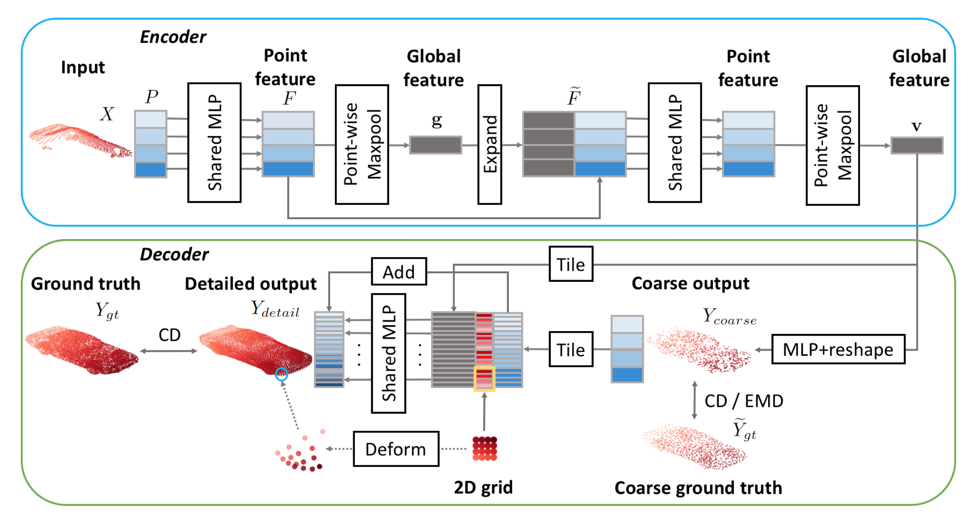
PCN Architecture
extended PointNet
two stacked PointNet Layers
permutation invariant
noise tolerant
two stage decoder:
coarse
detailed
fully-connected decoder
Chamfer Distance
loss
folding-based decoder
patch surrounding the coarse point

Slide 20
decoder: combination of fully-connected decoder(predicting spare set of points, i.e. global geometry) and folding-based decoder(approximating a smooth surface, i.e. local geometry)
two stages:
coarse output: v → fully connected layers → Y_coarse
detailed output: 2D grid per every coarse point, fold 2D grid into 3D surface

Slide 21
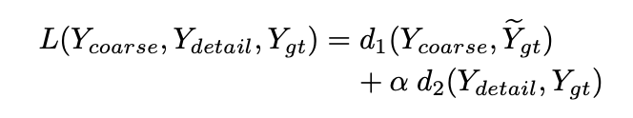
Chamfer distance: looks at the nearest neighbor distances between two point clouds (Note: gt <-> output)
Earth Mover’s distance: penalizes point density differences more effectively, expensive to calculate
PCN loss:
}
}
outputs
downsampled gt
coarse shape loss
detailed shape loss
d1: CD or EMD
d2: CD

Slide 22

PoinTr
Problem: loss of fine grained information when the point cloud is compressed into a single vector, max pooling, encoder-decoder based approaches
Method: set-to-set translation via Transformer encoder/decoder
DGCNN -> point proxy(center point + surrounding local geometry) extraction
self-attention: long sequences
cross-attention: learn attention map
point proxy

Slide 23
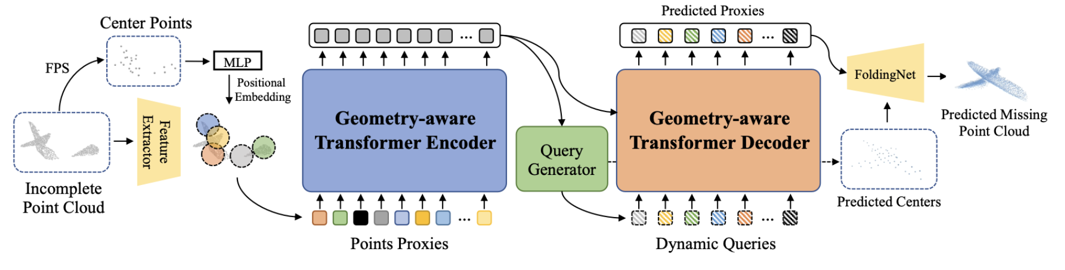
eg. two legs of a chair
dynamic graph CNN, local geometry feature extraction
i.e. tokens, to make point clouds suitable for transformers
dynamically conditioned on the encoder outputs
transformer’s self attention mechanism lacks inductive bias

Slide 24
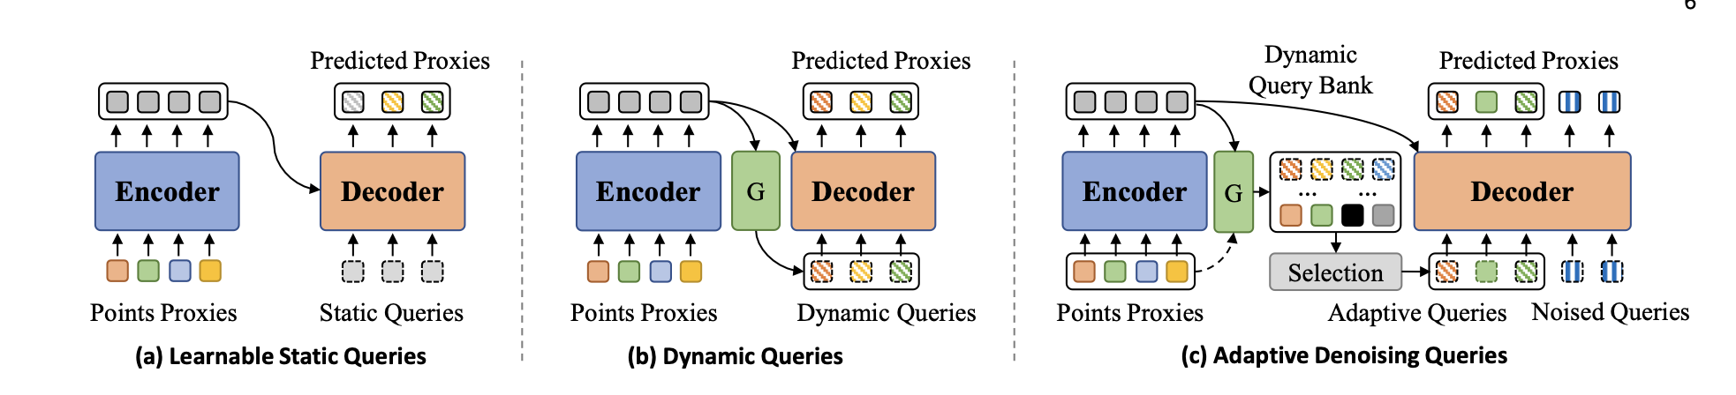
Extra: AdaPointr(Same Group)
M candidate queries, bcs. not every point cloud is incomplete at the same level

Slide 25
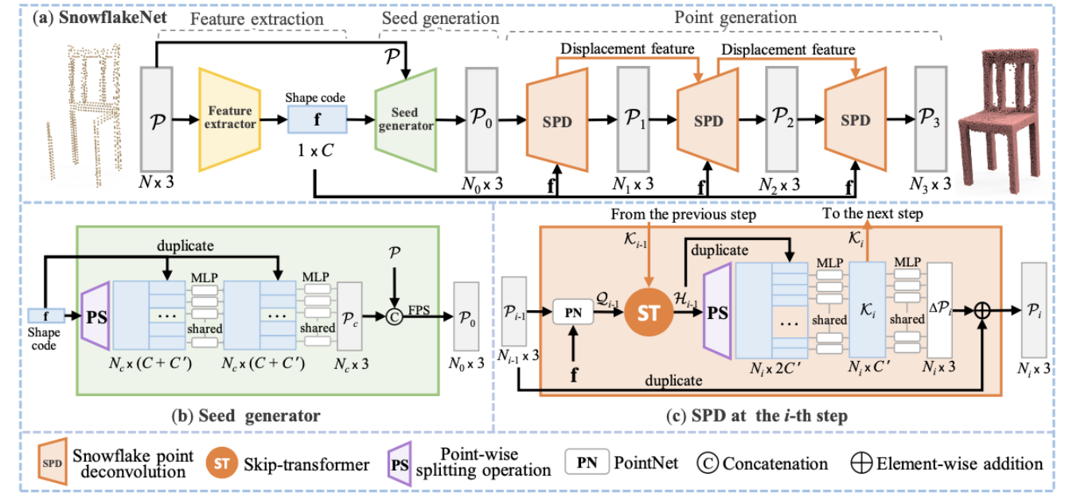
SnowflakeNet
using the shape codes, less #

Slide 26
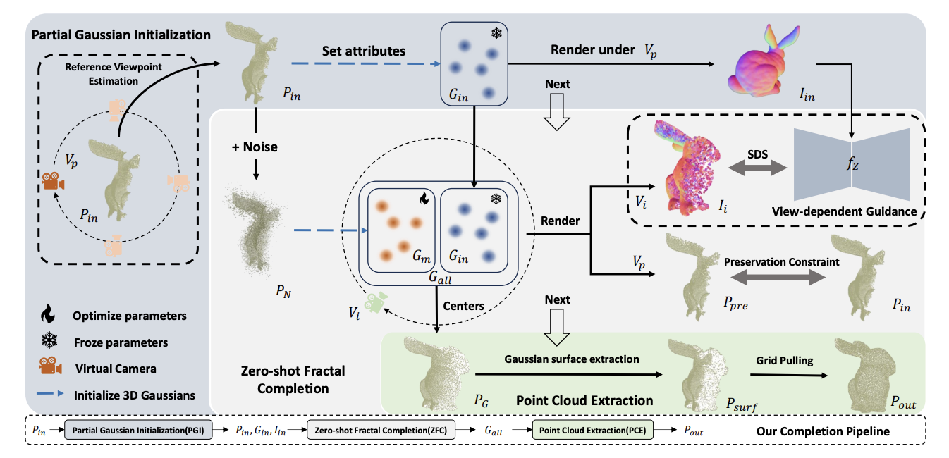
Extra: ComPC

Slide 27
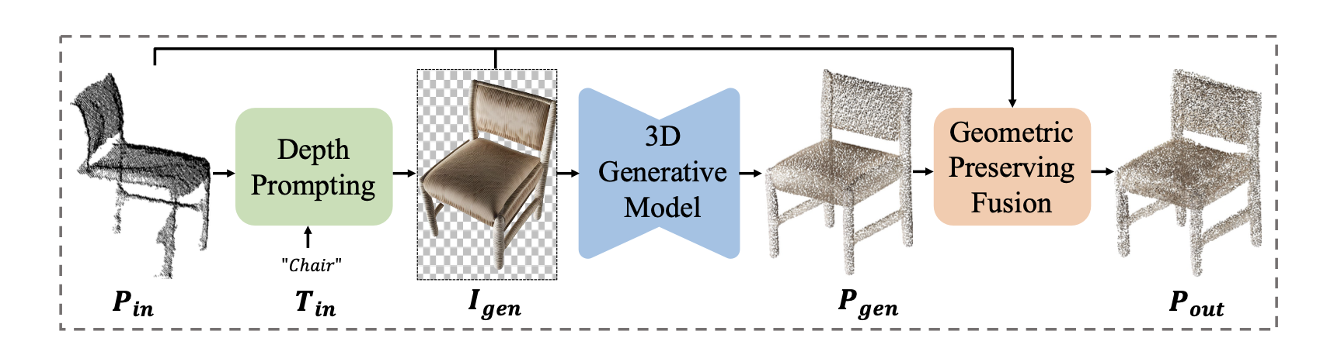
Extra: GenPC

Slide 28
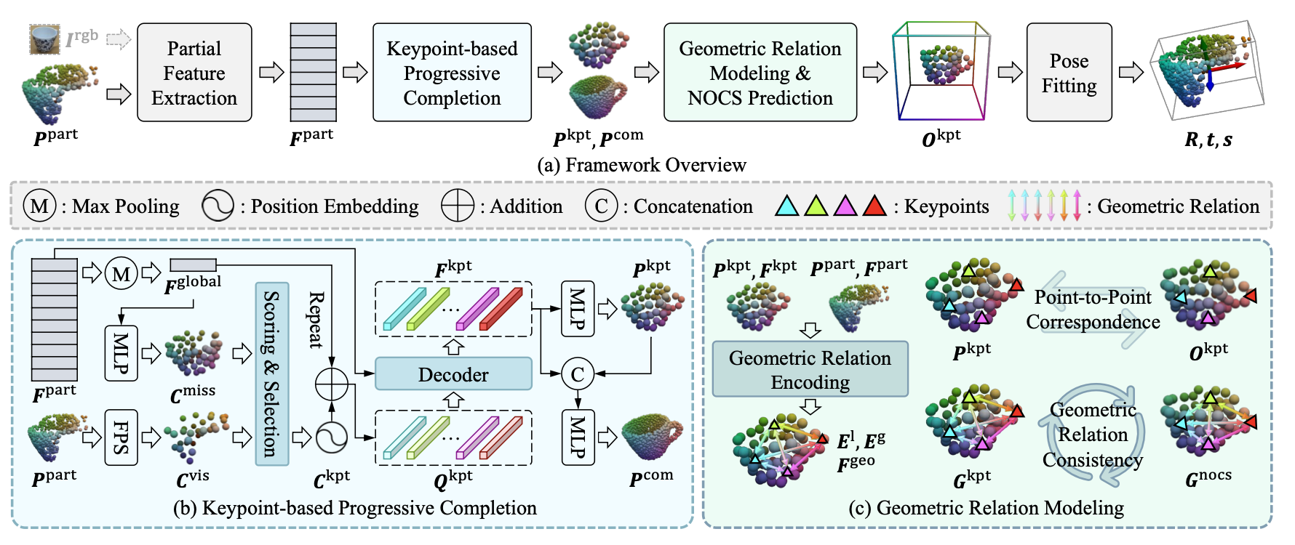
Extra: ComPose

Slide 29
Scene Flow / 3D Motion Estimation
given two 3D point clouds taken at different times, estimate the 3D motion vector of each point

Slide 30
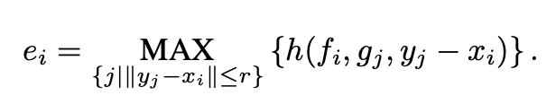
FlowNet3D
Problem: object motion, viewpoint change, no correspondence
set conv layer
flow embedding layer ->
set upconv layer

Slide 31
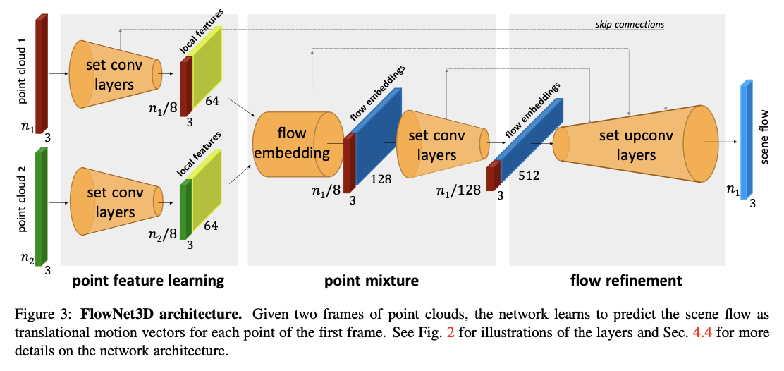
feature extraction
similarity, motion feature extraction per every candidate match
coarse
like a decoder

Slide 32
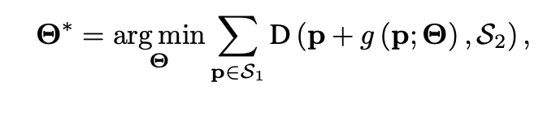
Neural Scene Flow Prior
Problem: training
Method: NO TRAINING, for each new pair, a small MLP is optimized from scratch at model runtime
neural prior

Slide 33
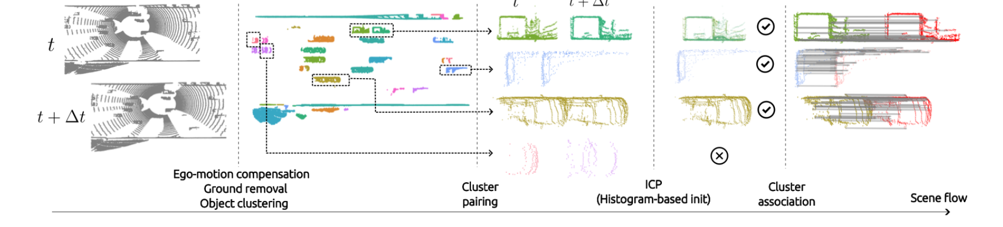
ICPFlow
to only get the object movements,
no background needed,
segmentation like
iterative closest point

Slide 34
Non-rigid Registration / Deformation
given two 3D point clouds taken at different times, estimate the 3D motion vector of each point

Slide 35
Lepard
Problem: match points when partial overlap, rigid/deformable scene
Method: KPFCN feature extraction -> positional encoding -> self/cross-attention Transformer -> differentiable matching -> soft Procrustes rigid fitting -> repositioning -> final matching
Note: Procrustes finds best alignment between two point sets

Slide 36
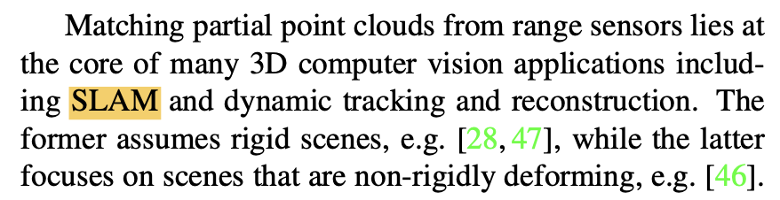
SLAM(Simultaneous Localization and Mapping)
Localization: estimating the sensor/robot’s current position and orientation
Mapping: building a map/model of the surrounding environment
SLAM: continuously matching sensor observations over time and update the map of the environment -> partial matching cloud problem

Slide 37
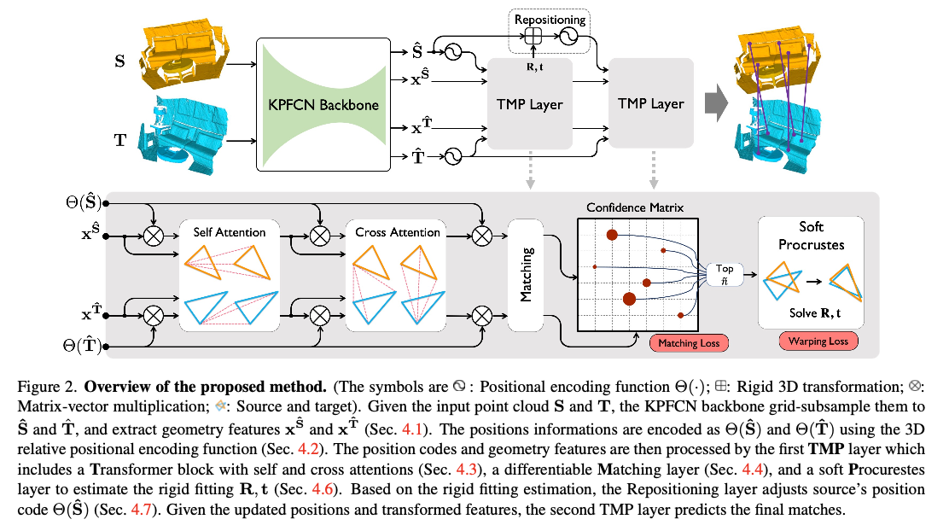
partial point cloud matching
downsampling & feature extraction
}
source
Transformer + Matching + Procrustes
target
positional codes
disentanglement between position and feature

Slide 38
Neural Deformation Pyramid
Problem: non-rigid point cloud registration
Method: hierarchical motion decomposition, sinusoidal position encoding

Slide 39
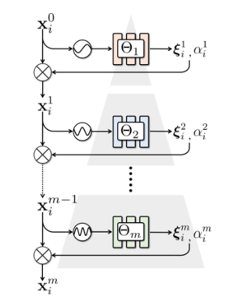
sinusoidal positional encoding
motion increment
deformability confidence

Slide 40

Neural Deformation Graphs
Problem: globally consistently reconstruction + track
eg. DynamicFusion: incremental deformation graph -> tracking error accumulation
Method: globally optimized neural deformation graph
(considering all sequence together)
position
rotation
weights

Slide 41
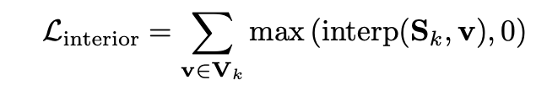
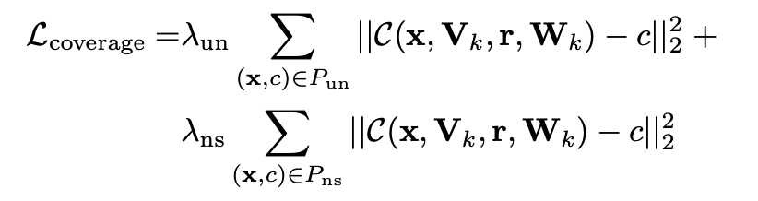
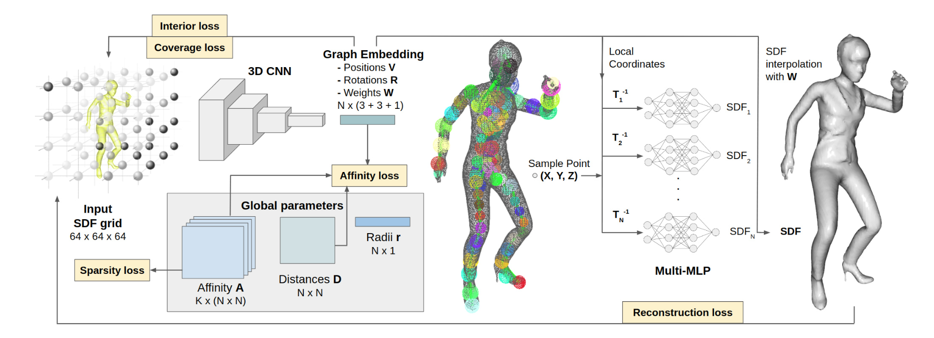
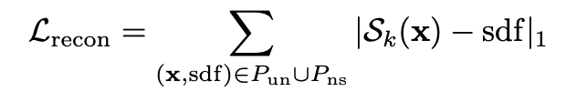
uniform
prevent nodes from remaining outside the object
graph nodes covering the object
near surface
deformation graph nodes
not point cloud!
prevent from becoming too densely correlated
graph connectivity

Slide 42
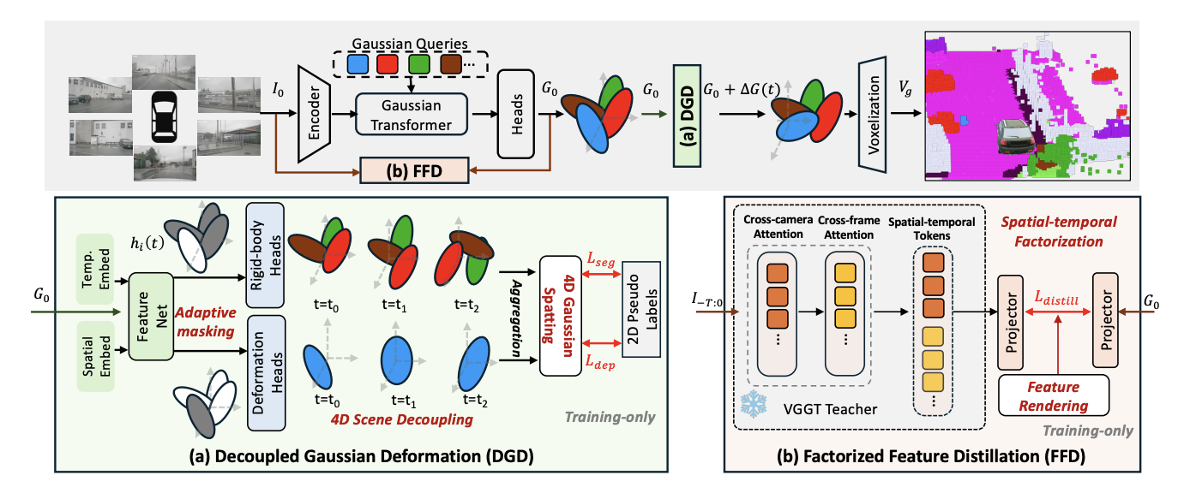
Extra: DeGO

